Slide 1
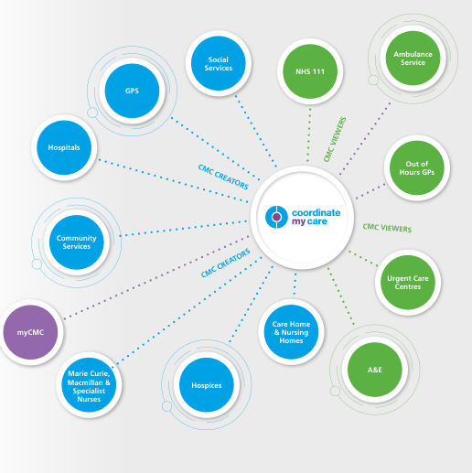
Letting the patients do the hard work in the privacy of their own home. myCMC enables patients to record their key contacts, wishes and preferences. It supports them to think through concepts such as resuscitation (aided by videos online). This helps clinicians because patients will have started thinking through difficult decisions with their family and friends before coming to the surgery for their consultations to complete their CMC plan.

Slide 2
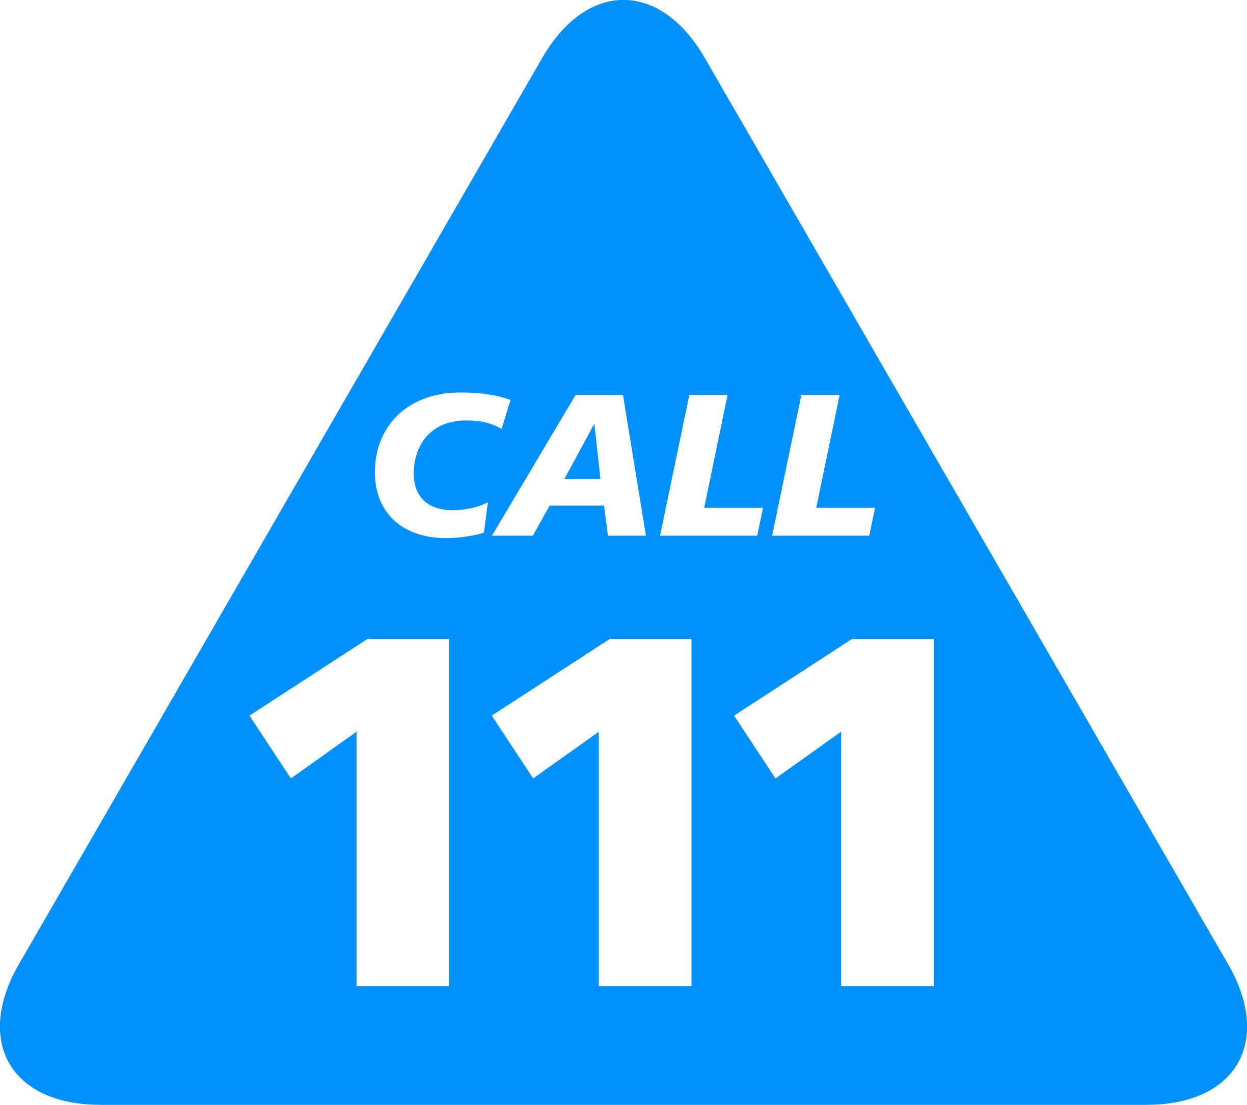
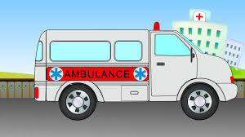
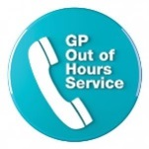
How myCMC works
GP identifies appropriate patients and send letter or email
Right Outcome:
Right care
Right team
Right place
Right costs
Patient Initiates, Edits, Views plans
Clinician Adds clinical details + Approves plan
Identification
Prospective through AI, MDTs or individual selection
Shared Decision Makers
Shared Information
Shared Benefits

Slide 3
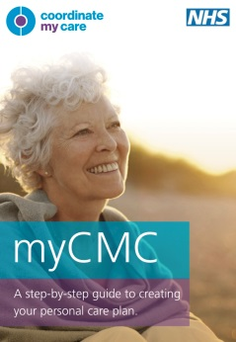
Step 1
Practice IDENTIFIES patients and sends a LETTER or EMAIL to patients; frail, end of life care, heart failure, COPD……
PRACTICE ADDRESS
date
Dear XXX
You have been identified by your GP as someone who might benefit from having an Urgent Care Plan. This is a plan where you express your personal wishes about your care, you tell us who to contact in an emergency and you help the urgent care services to know about you.
If you are interested in starting a plan, please go on line to www.mycmc.online and start your questionnaire. Once you have completed it, press the submit button and your plan will come to the GP surgery. Then make a telephone appointment with your GP and we will complete your plan by adding your diagnosis, medications you take and what to do in an emergency. Your plan is then approved and it is called a Coordinate My Care (CMC) plan . Your CMC plan is immediately available for all the urgent care services to see when they need to. This includes 111, the out of hours GPs, the ambulance service and the Emergency Departments across London.
CMC is what it says on the tin – it coordinates the care around you.
You may like to print off the leaflet attached so you can read through it and discuss it with your family before you get started. https://www.coordinatemycare.co.uk/wp-content/uploads/2019/11/CMC_Patient_Flyer_Artwork_v11.pdf
For more information about Coordinate My Care you can access a step-by-step guide on our website at coordinatemycare.co.uk. Click on the myCMC tab and then look for the purple button which reads ‘View step-by-step guide’.
At times when the surgery is closed, if you need help and you call 111, 999 or the out of hours GP services they will all be able to access your CMC plan and know how to help you in an emergency.
If you have any queries please do not hesitate to call the surgery.

Slide 4
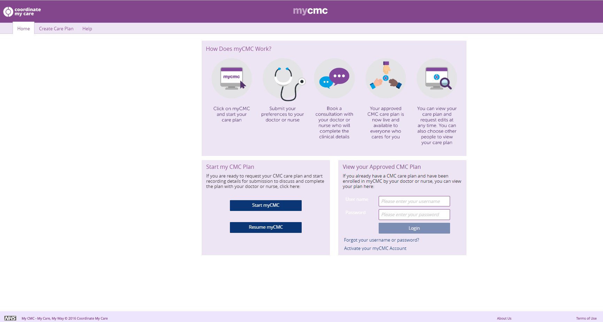
Step 2
Patient goes online
Patient goes online to
www.mycmc.online

Slide 5
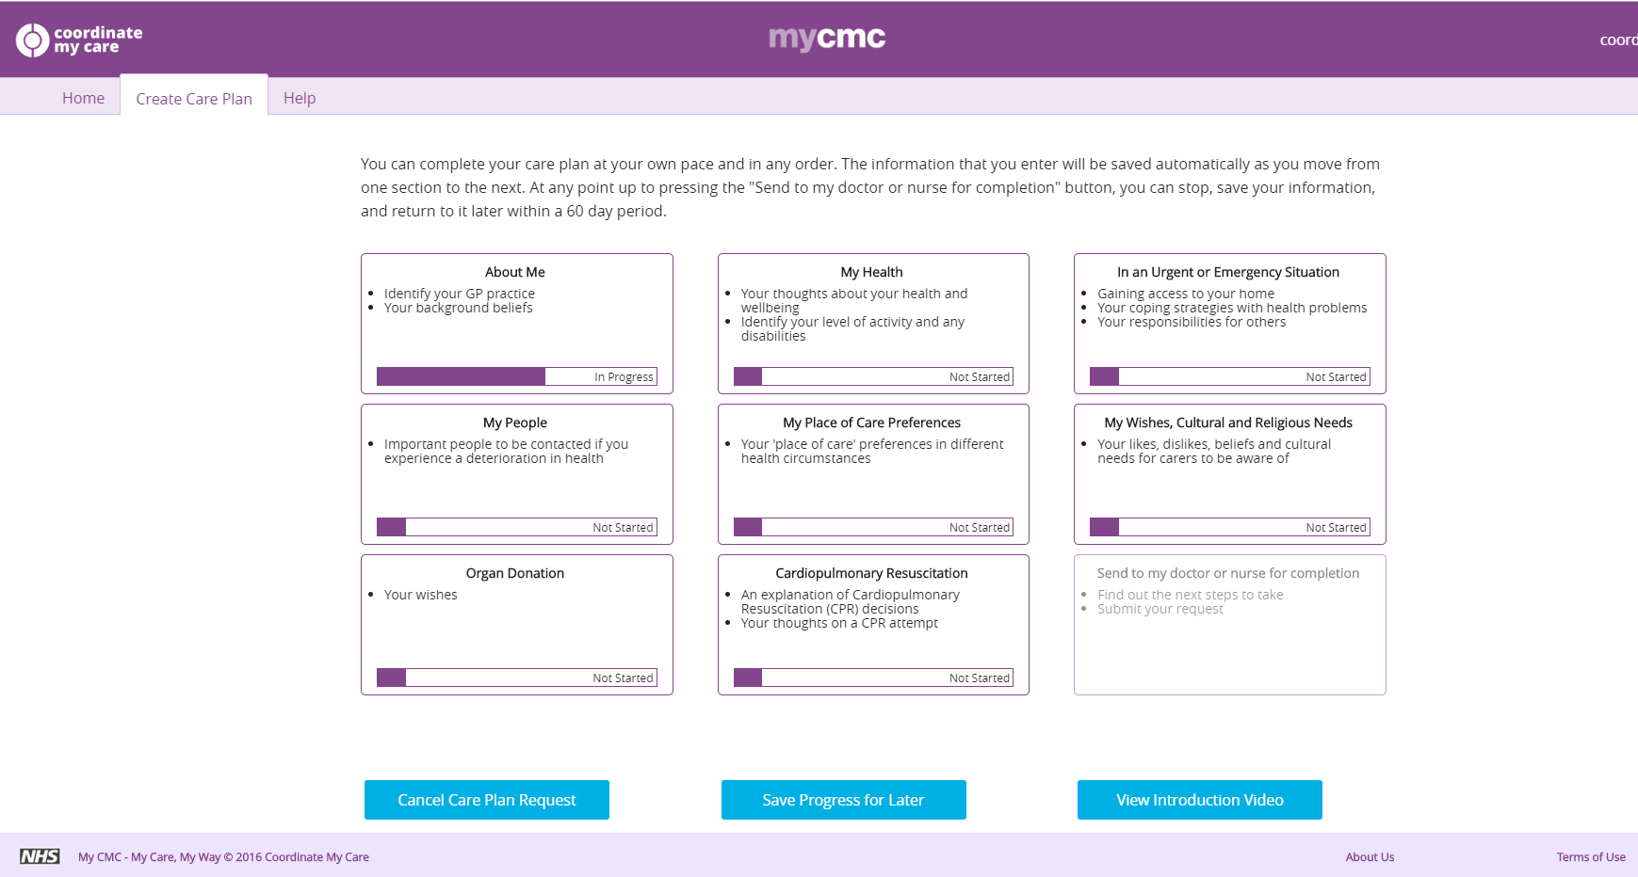
Step 3
Patient fills in online questionnaire

Slide 6
Step 4
Patient listens to videos explaining resuscitation and fills in their preference (CPR is a medical decision but it’s helpful for GPs to know what their patient is thinking)

Slide 7
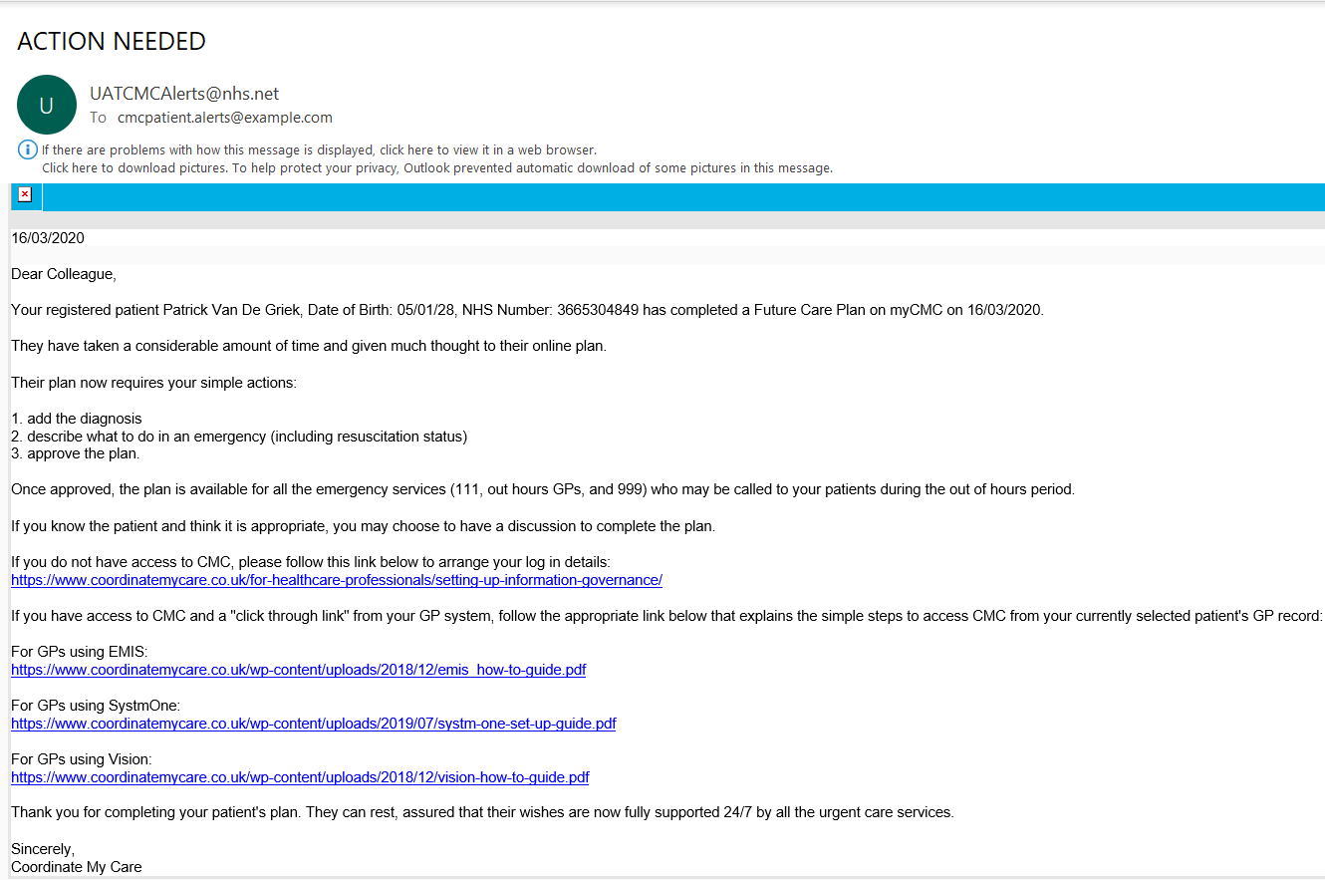
Step 5
Patient completes myCMC questionnaire and presses submit –
myCMC sends an automated alert to GP practice email address (see below) to notify GP to finalised the draft care plan for the patient
Email notification in GP practice email tray
submit

Slide 8
Step 6
Patient makes appointment with GP or Practice Nurse alone or with family/friend

Slide 9
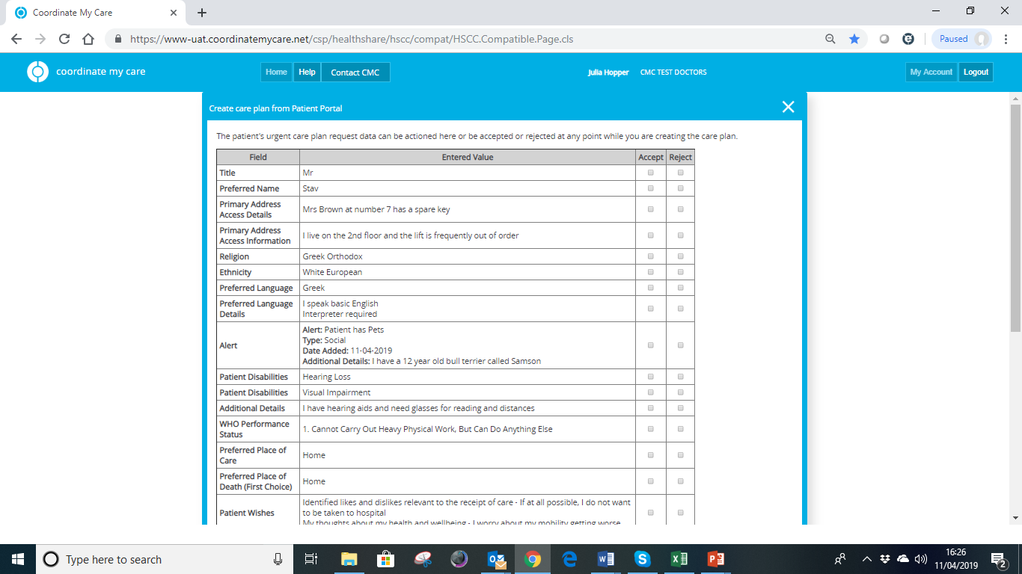
Step 7
GP opens patient’s EPR (EMIS, Vision or TPP), clicks into CMC and sees summary of patient’s myCMC plan
Clinician can accept all, or accept /reject individual entries

Slide 10
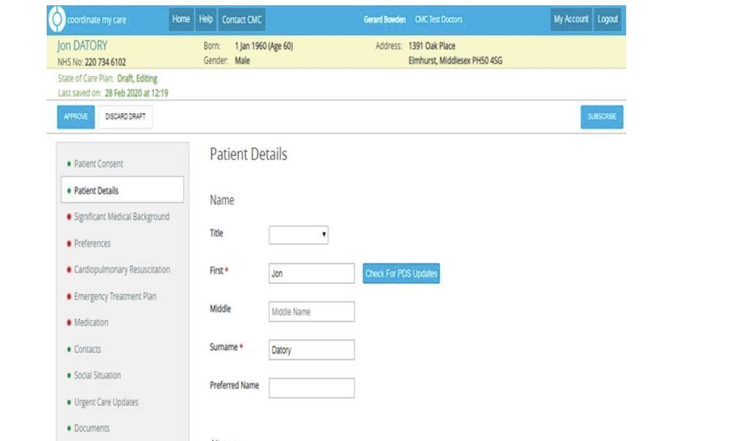
Step 8
All accepted entries auto-populate directly into the patient’s CMC plan
Clinician fills in mandatory fields; Medical background, CPR and emergency treatment plan. (Medications will auto-populate from GP system by the Autumn 2020)

Slide 11
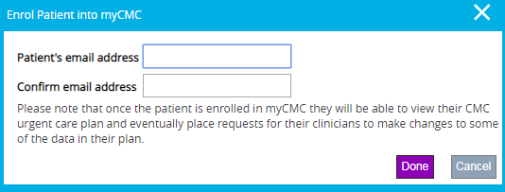
Step 9 GP enrols the patient to view their care plan – 30 seconds Once enrolled the patient can view their own care plan on their smart phone or other personal device.

Slide 12
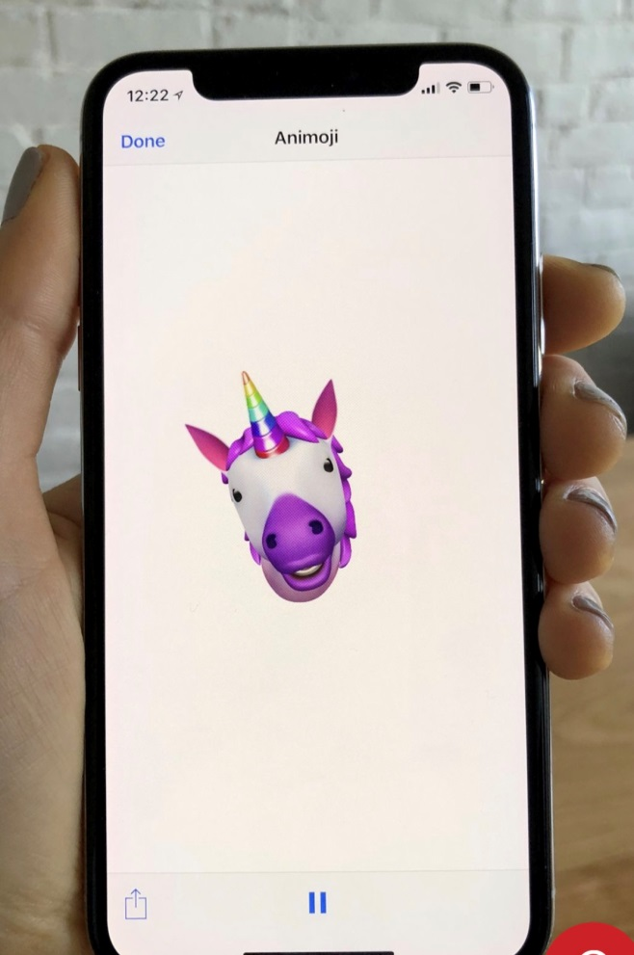
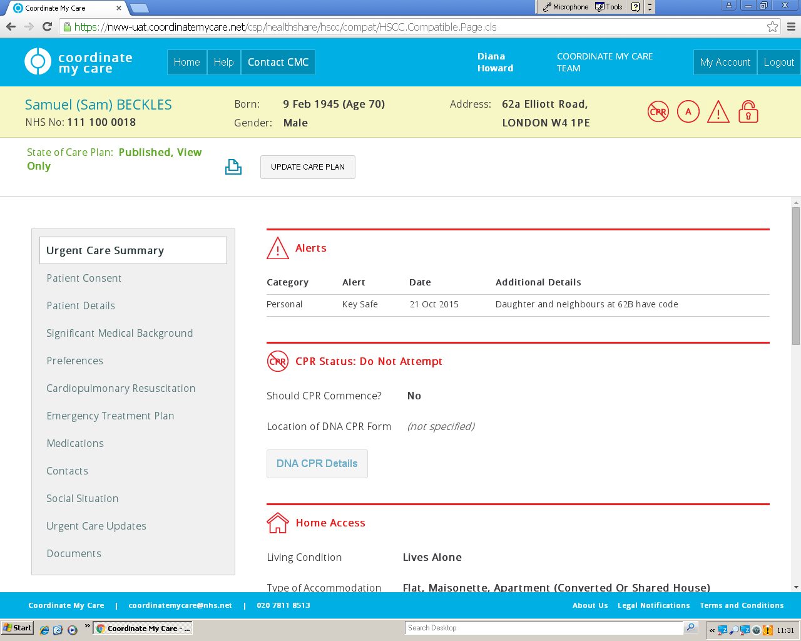
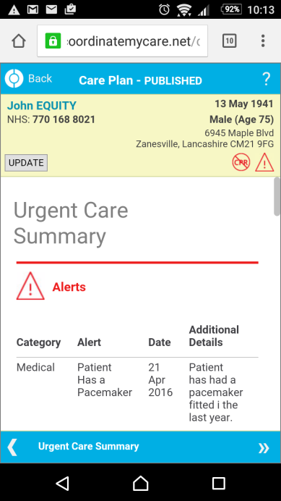
Step 10
Patient views same urgent care plan on smartphone as seen by all urgent care services e.g. paramedic in the ambulance vehicle
Patient
111, 999, OOH GPs, GPs, EDs

Slide 13
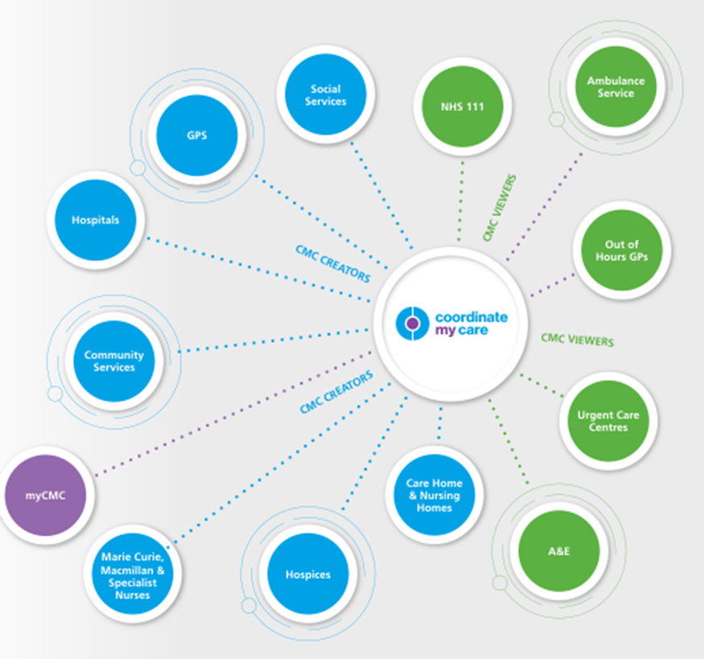
Step 11
Everyone is joined up – CMC is a single version of the truth

Slide 14
Step 11
GP can use the CMC list to review all the plans at MDT e.g. at end of life care, heart failure, COPD meetings

Slide 15
Advantages of CMC
PATIENTS
Have a voice
Take time to watch videos and understand concepts such as resuscitation
Start difficult ‘conversation’ with their families/carers as they create their plans in
their own homes
Supported 24/7 even when GP surgery is closed
Are not strangers to the urgent care services
DOCTORS/NURSES
Do not have to start the conversations, patients arrive at consultation prepared
Patients have done the hard work before coming to the consultation so takes less
time to complete the plan
Patients are identified systematically so do not have to be randomly identified in a
10 minute consultation
Avoid unnecessary admissions for their patients and delivers better care

Slide 16
FOR FURTHER INFORMATION:
Coordinate My Care helpdesk 0207 811 8513
www.coordinatemycare.co.uk

